Slide 1
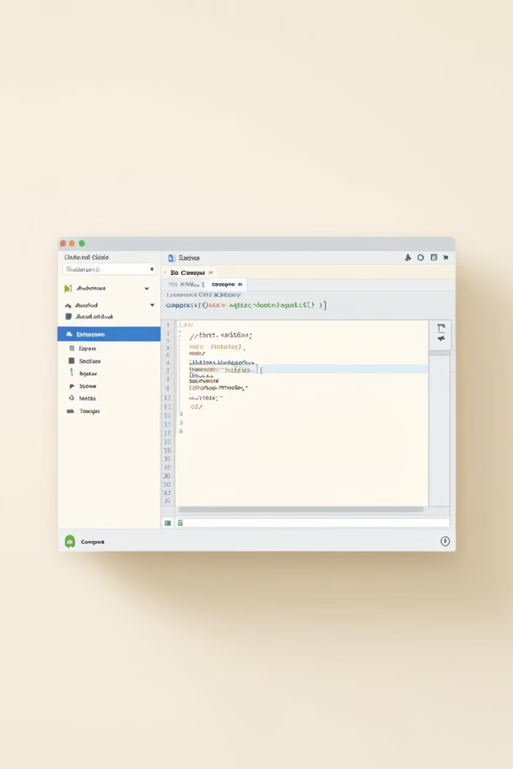
A Demonstration of Text Input and Validation with Android Compose
TEAM MEMBERS :
P.SAKTHIVEL(1597EA78FCA7B0FB3624205ABEC01091)
R.SATHISH(00E5D210BD3135783314385E57929738)
R.SHANMUGAM(07A01FBFB633AD7B8AB4D936682F324E)
P.RAJESHWARAN(0B579486CA1A2719D0F43714E82F4C36)
G.SIVAPRAGASAM(10DA8659C39D11E877546A627950070A)

Slide 2
A Demonstration of Text Input and Validation with Android Compose
This presentation explores the fundamentals of text input and validation in Android Compose, a modern declarative UI toolkit for building beautiful and responsive Android applications.

Slide 3
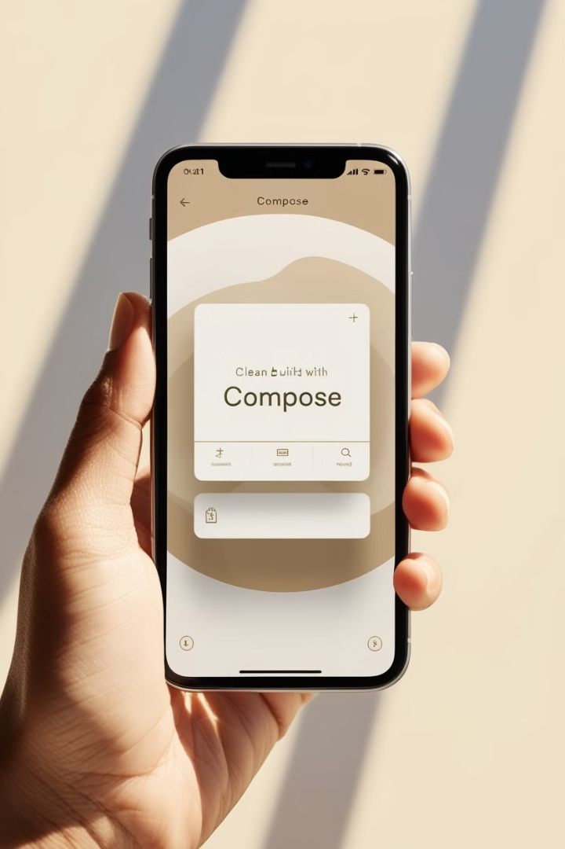
Introduction to Android Compose
1
Declarative UI
2
Kotlin-Based
Compose emphasizes describing the UI's state rather than managing intricate view hierarchies.
Compose leverages Kotlin, a concise and expressive language, for writing UI code.
3
Jetpack Integration
4
Improved Performance
Compose integrates seamlessly with other Jetpack components, providing a unified development experience.
Compose's efficient rendering engine leads to smoother and faster UI updates.

Slide 4
Exploring Text Input in Compose
TextField
Customization
Input Types
The core component for handling user input, allowing users to enter and edit text.
Compose provides a wide range of properties to style and customize the appearance of TextFields.
Support for different input types, including text, numbers, passwords, and emails.

Slide 5
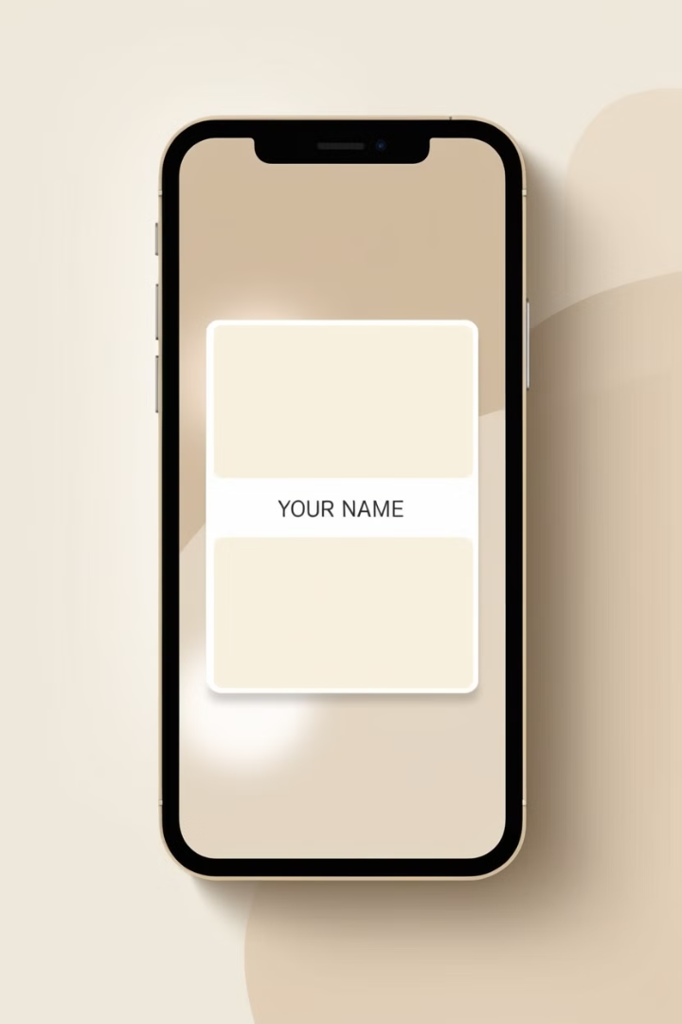



Implementing Basic Text Input
Import the Required Library
Import the necessary Compose library to access the TextField component.
Create a State Variable
Define a state variable to store the text entered by the user.
Render the TextField
Use the TextField component to display the input field and bind it to the state variable.

Slide 6

Handling Text State and Updates
1
onValueChange
A lambda function that updates the state variable whenever the user modifies the input text.
2
State Management
Manage the input text state effectively using state variables and composable functions.
3
Single Source of Truth
Maintain a single source of truth for the input text, ensuring consistent UI updates.

Slide 7
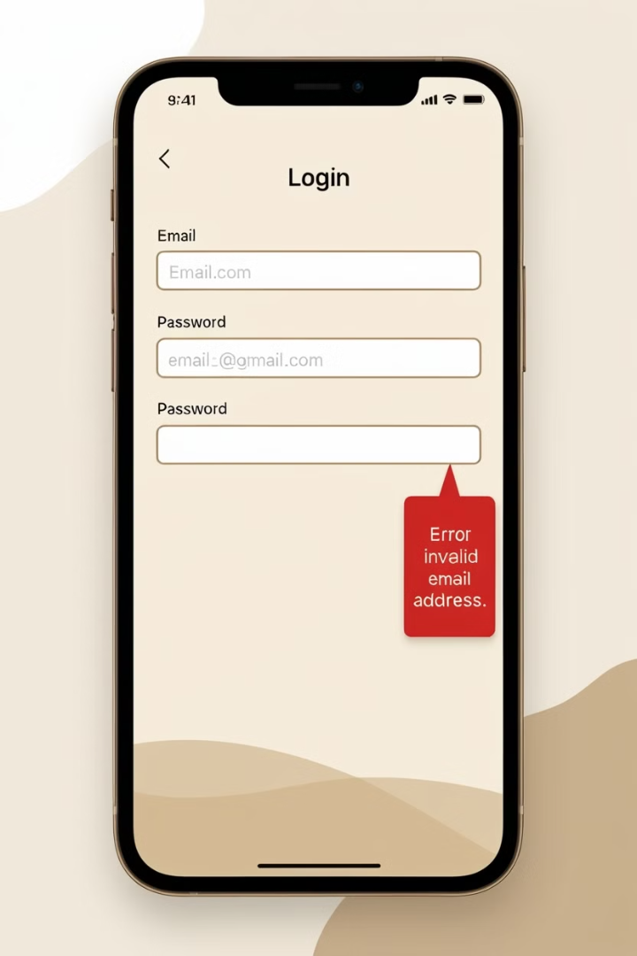
Validating User Input
Validation Rules
Error Handling
Define rules to check the validity of the input text, such as length, format, and specific patterns.
Implement error handling mechanisms to inform the user about invalid input and provide guidance.
Validation Logic
Implement validation logic using functions or conditions to evaluate the input text against the rules.

Slide 8
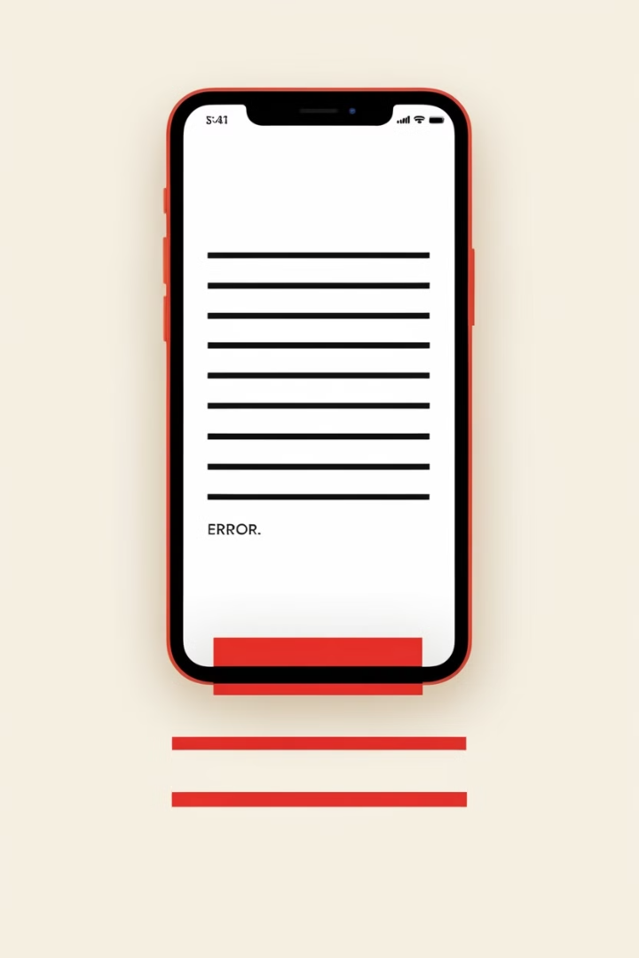
Displaying Validation Feedback
Error Messages
Provide clear and concise messages explaining why the input is invalid.
Visual Indicators
Use visual cues such as red borders, error icons, or color changes to highlight invalid input.
User Guidance
Provide suggestions or instructions to help users correct invalid input.

Slide 9
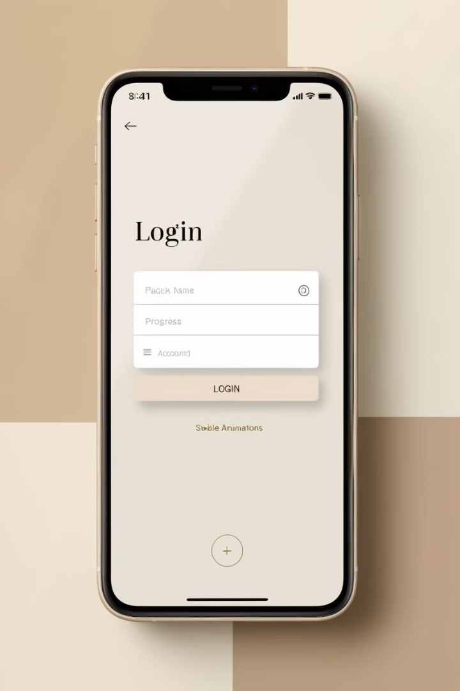



Best Practices for Text Input in Compose
Keyboard Navigation
Enable efficient keyboard navigation for better user experience.
Accessibility
Ensure proper accessibility for users with disabilities.
Performance Optimization
Optimize input handling for smooth and responsive performance.

Slide 10
Definition of Jetpack Compose:
Jetpack Compose is Android’s modern toolkit for building native UI, streamlining development with declarative programming and reducing boilerplate code.
Why Compose is Important: C
ompose allows developers to create more intuitive, responsive UIs by focusing on the UI's state, enhancing development speed and flexibility.
Adoption in the Industry: As Compose continues to mature, it is increasingly adopted in mobile development, with major apps integrating it for better maintainability and scalability.
Overview of Android Compose

Slide 11
Introduction to TextField Component:
The TextField component in Compose is used to capture user input, providing essential attributes like placeholder, value, and onValueChange for real-time updates.
Customizing the TextField Appearance:
Compose offers flexibility in customizing TextField’s appearance, including styling, padding, and colors, to match design requirements.
Single vs. Multiple Line Input: TextField can be adjusted to support single or multi-line inputs, accommodating diverse input types such as comments, addresses, or short-form fields.
TextField Basics in Compose

Slide 12
Understanding State in Compose:
State is central in Compose; it enables UI elements to respond dynamically to user input, providing reactivity across the UI.
Using remember and mutableStateOf:
Compose uses remember and mutableStateOf to store and update state, making the TextField responsive to input changes.
Managing Input Changes: With onValueChange, developers can validate or manipulate user input as it changes, creating a responsive and user-friendly experience.
State Management with Text Inputs

Slide 13
Importance of Input Validation
Security and Data Integrity: Input validation ensures that the data entered is correct, reducing security risks like SQL injection, buffer overflows, and input corruption.
User Experience Enhancement: Immediate validation feedback enhances user experience by preventing submission of incorrect data, thus improving app reliability.
Error Handling Approaches: Validation helps manage errors proactively, reducing app crashes and improving stability by handling invalid inputs gracefully.
Input Validation Techniques

Slide 14
Using Regular Expressions (Regex): Regular expressions allow for sophisticated validation patterns, handling complex input formats like emails, phone numbers, and passwords.
Custom Validation Logic: Compose enables custom validation functions to check for specific conditions or requirements based on user input, enhancing flexibility.
Combining Validations: Multiple validation checks can be layered for fields with complex requirements, such as passwords, ensuring high data accuracy and compliance.
Advanced Validation Techniques

Slide 15
Form Submission Workflow
Composing Forms in Compose: Forms with multiple TextFields in Compose can capture varied inputs, like user profile data, contact forms, or checkout pages.
Handling Form State: Storing form data in a centralized state allows for streamlined validation and submission, reducing bugs and improving code readability.
Form Reset and Error Handling: Features like form reset and error display (e.g., missing fields) contribute to a smoother user experience and provide clear feedback.
Implementing Real-World Scenarios

Slide 16
Custom Error Messages: Meaningful error messages guide users on how to correct their input, enhancing both accessibility and user satisfaction.
Accessible Validation Cues: Ensuring validation feedback, such as error icons or helper text, is accessible improves the experience for visually impaired users.
Testing for Accessibility Compliance: Compose’s tools allow developers to test validation and input fields to meet accessibility standards, creating inclusive apps.
Error Messages and Accessibility

Slide 17
Efficient State Management: Minimizing recompositions by managing state effectively in Compose reduces lag, enhancing input field performance.
Debouncing Input: Techniques like debouncing prevent excessive recompositions for fields with fast input changes, like search bars, improving responsiveness.
Managing Large Forms: For extensive forms, dividing fields into smaller, manageable sections keeps performance high and prevents UI slowdown.
Performance Optimization in Input Fields

Slide 18
Adapting to API Updates: Staying updated with new Compose releases helps maintain code compatibility, especially as input handling evolves.
AI for Validation: Leveraging AI for complex validations, like analyzing free-text inputs, can enhance user experience and data quality.
Improving UX with Predictive Text and Suggestions: Adding predictive text or auto-suggestions can simplify data entry, reducing input errors and enhancing usabili
Future of Input Validation in Compose

Slide 19
Handling Edge Cases in Input: Addressing scenarios like empty fields, null values, or unexpected characters ensures stability in various user contexts.
Network Errors on Submission: Handling network or API errors during form submission prevents data loss and improves user trust by managing issues gracefully.
Optimizing Error Messages for Clarity: Error messages should be clear and actionable, making it easy for users to understand and resolve issues quickly.
Error Handling and Edge Cases

Slide 20

Conclusion and Key Takeaways
1
Powerful Tool
2
User Experience
3
Validation is Key
Compose provides a robust and intuitive way to implement text input and validation.
Focus on creating a seamless and user-friendly experience for text input.
Implementing validation is crucial for ensuring data integrity and providing helpful feedback to users.

